Slide 1
Classification of Web Documents using KNN
Muhammad Kabir Ahmad
2021-CS-4
Syed Hashir Husnain
2021-CS-1

Slide 2

Scrapping Technique
Used
Node + Cheerio+ Axios
Reasons :
We can scrap data using CSS selectors from cheerio by Axios. e.g: .div, .tag
and many more
We used node as we had done web scrapping in python using selenium so for our
new experience.

Slide 3
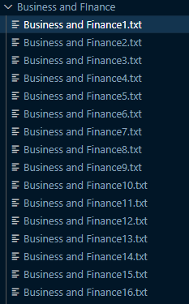
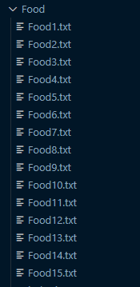
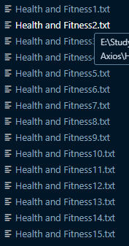
Results (Scrapped Data)
Scrapped Data Files as per assigned 3 Classes
Food
Business and Finance
Health and Fitness

Slide 4
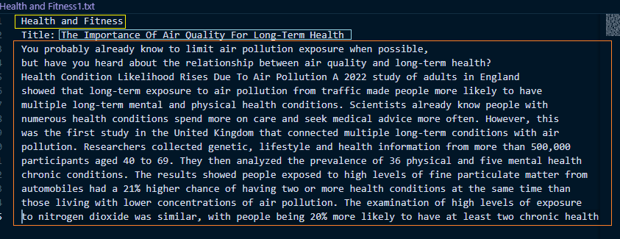
Results (Scrapped Data)
Structure of Scrapped Data Files
Topic
Label
Data

Slide 5


Pre-Processing
.
Tokenization
In Tokenization, We convert Sentence into words.
.
Stemming
It makes stem words and clearing the extra number and convert the doc data into lower case.
.
Output
Stem words as a process data.
Tokenization
Stemming

Slide 6
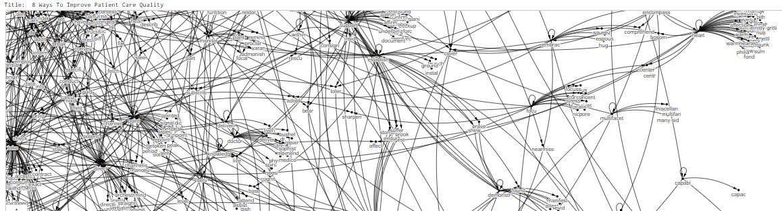
Graph of each document

Slide 7
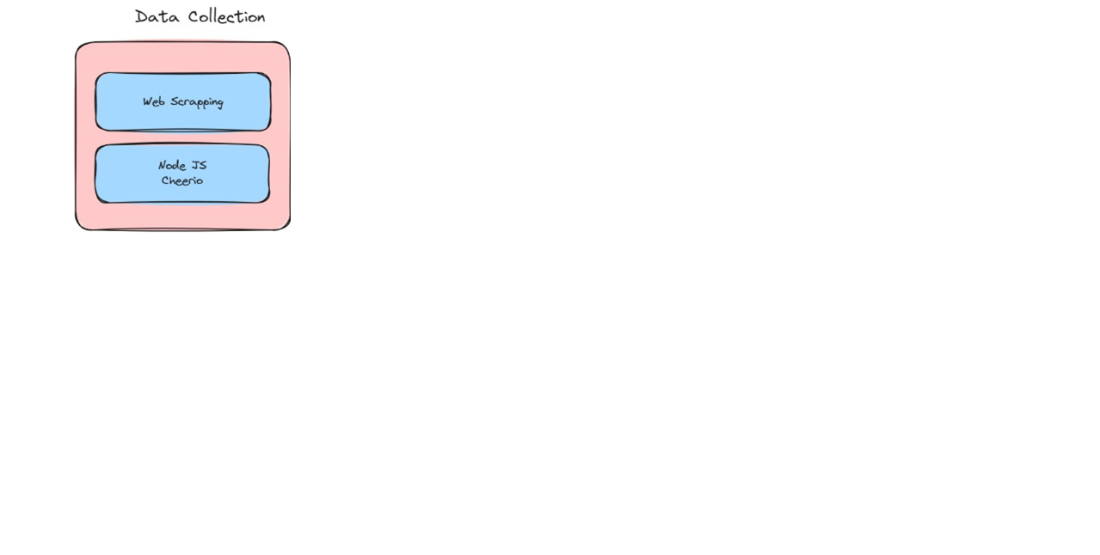
Project Overview

Slide 8
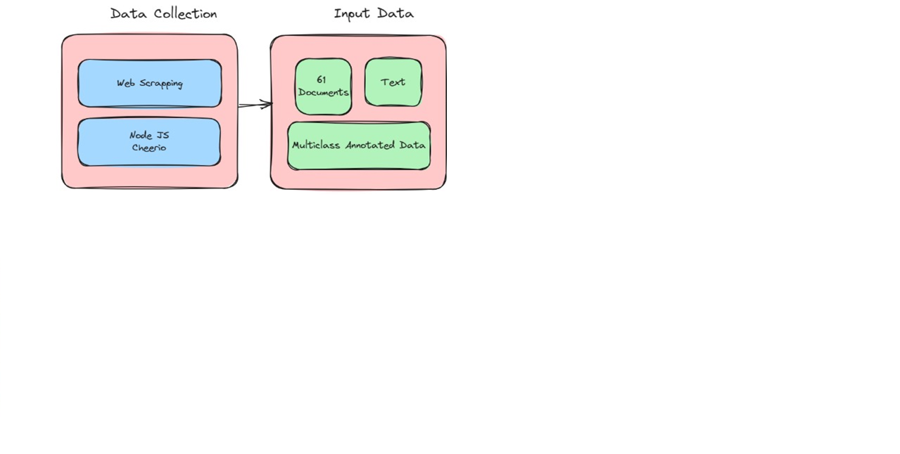
Project Overview

Slide 9
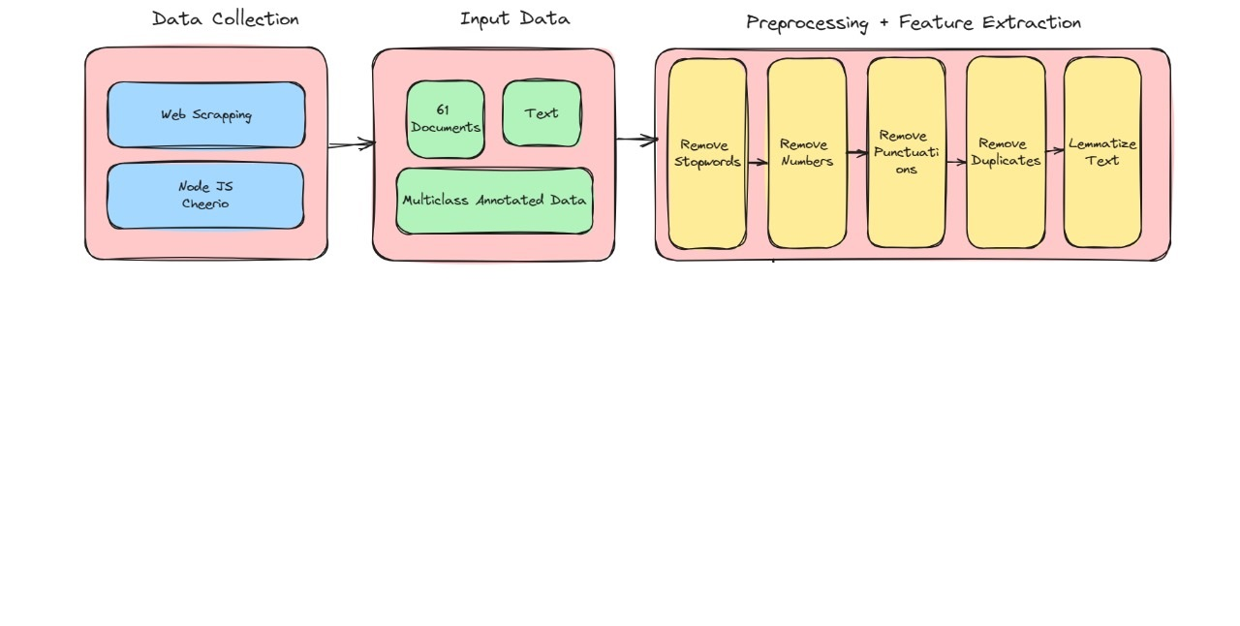
Project Overview

Slide 10
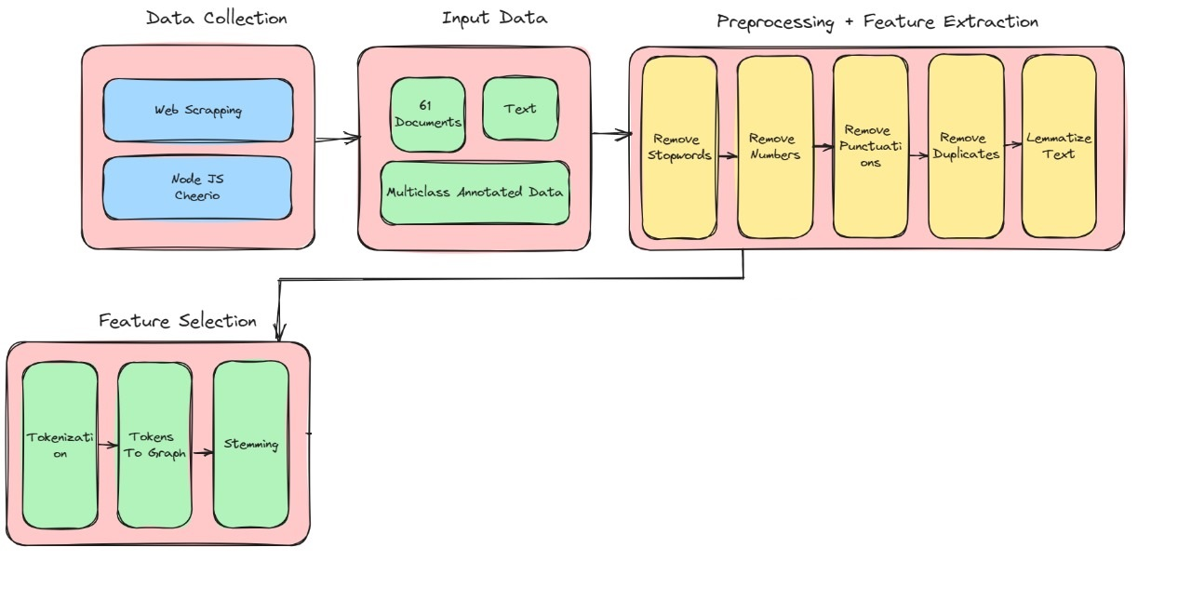
Project Overview

Slide 11
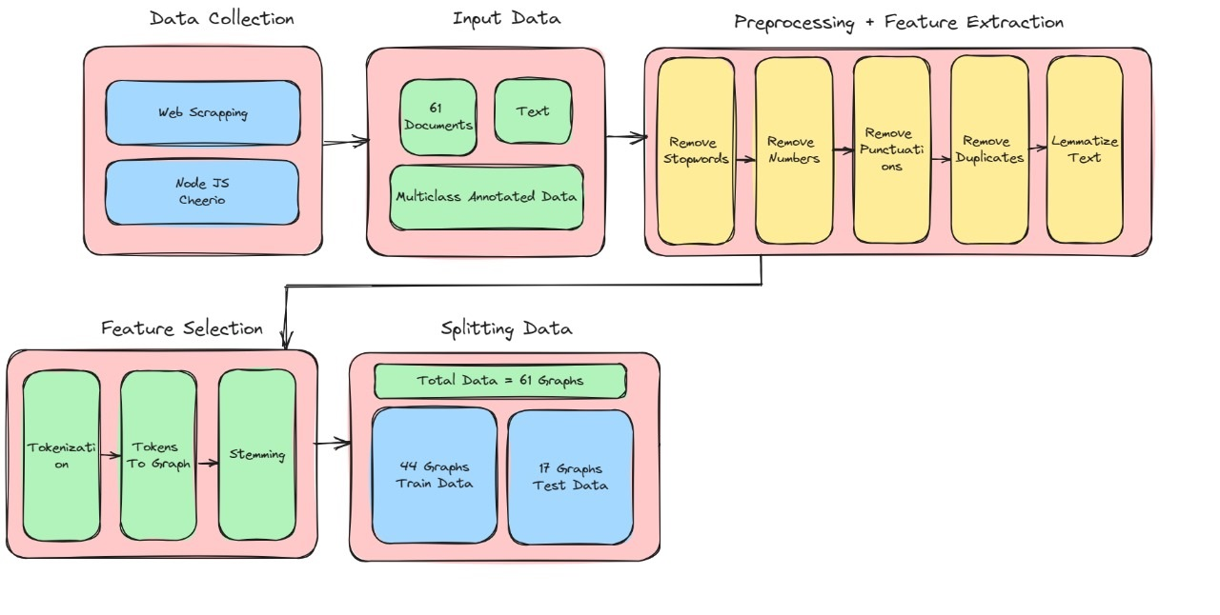
Project Overview

Slide 12
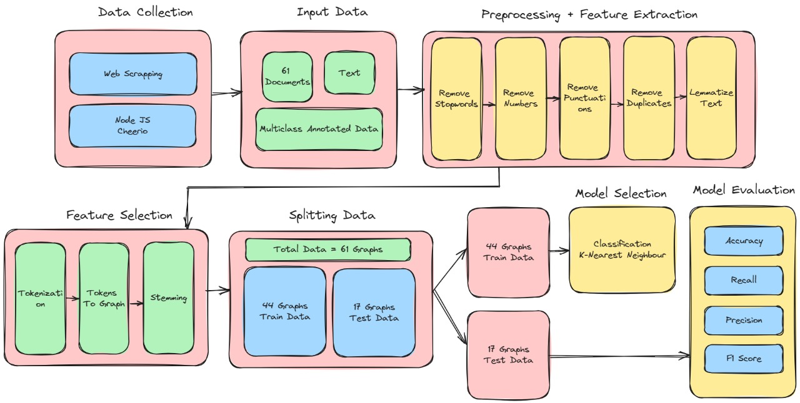
Project Overview

Slide 13
Thank You

